Slide 1
Circulatory disturbances

Slide 2
Chronic venous congestion : liver

Slide 3
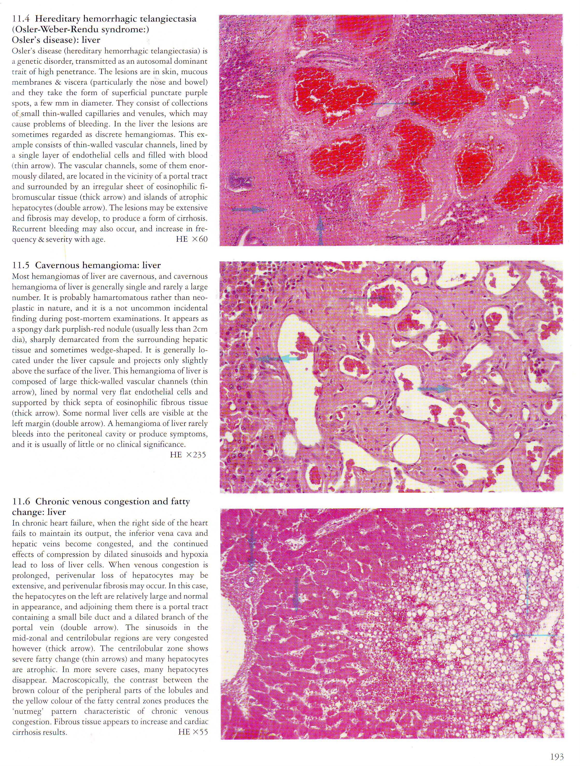
Chronic venous congestion : liver

Slide 4
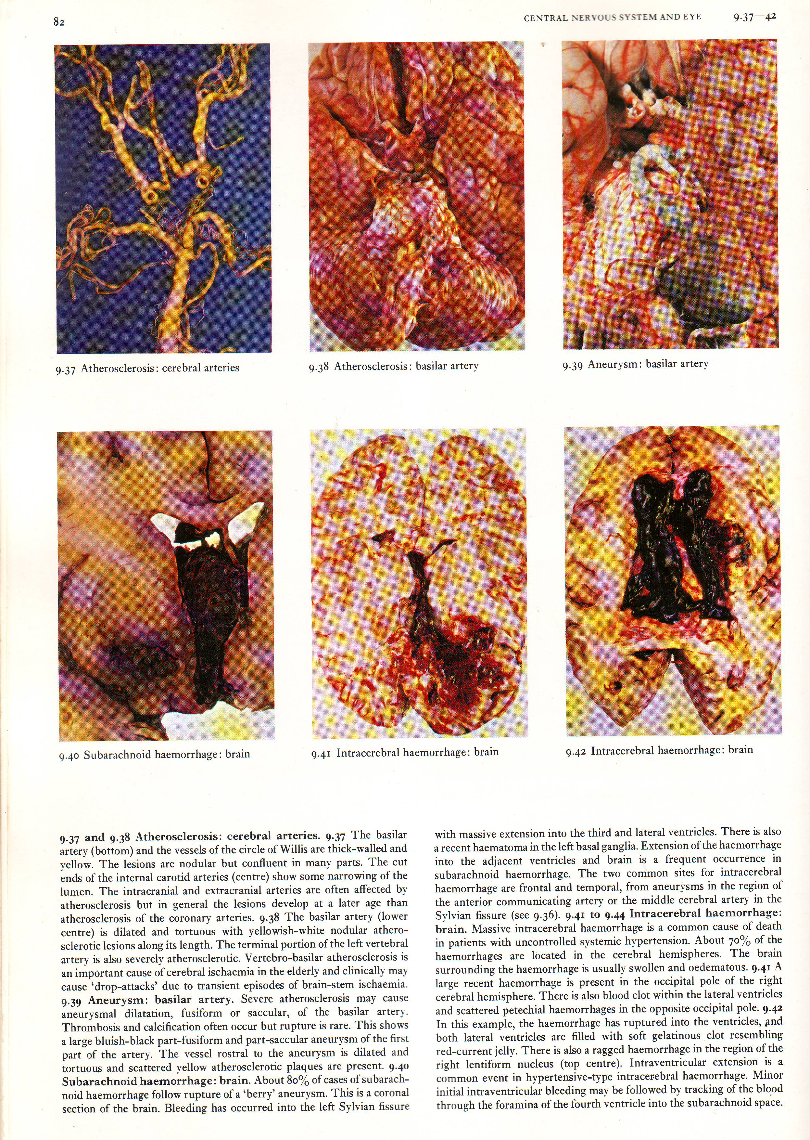
Intracerebral hemorrhage : brain

Slide 5
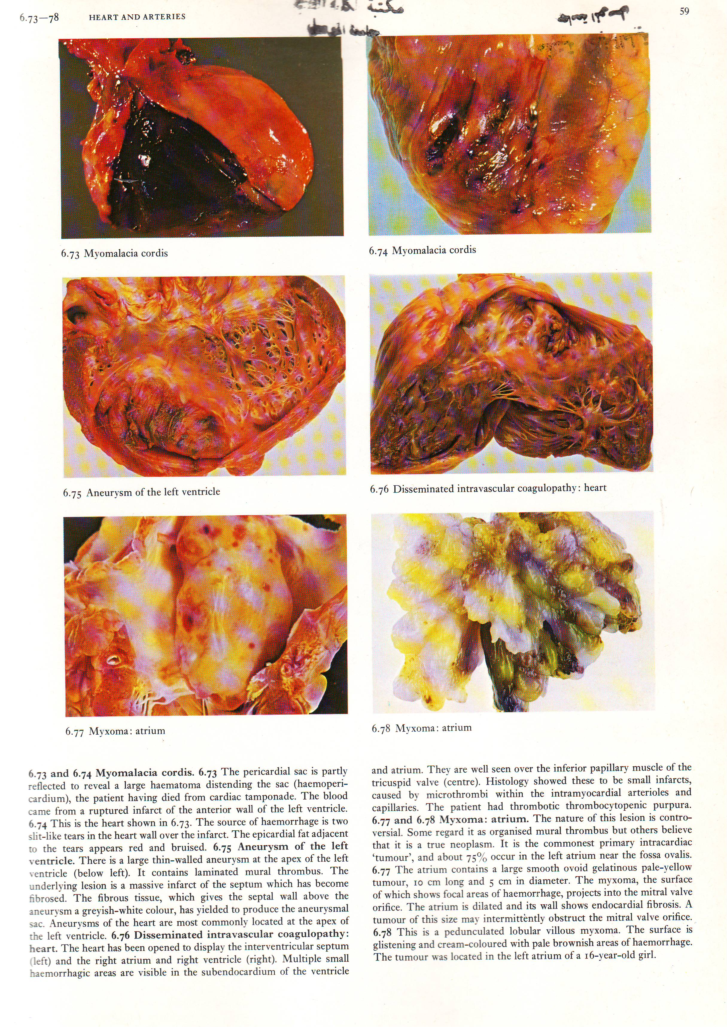
Hemopericardium : heart

Slide 6
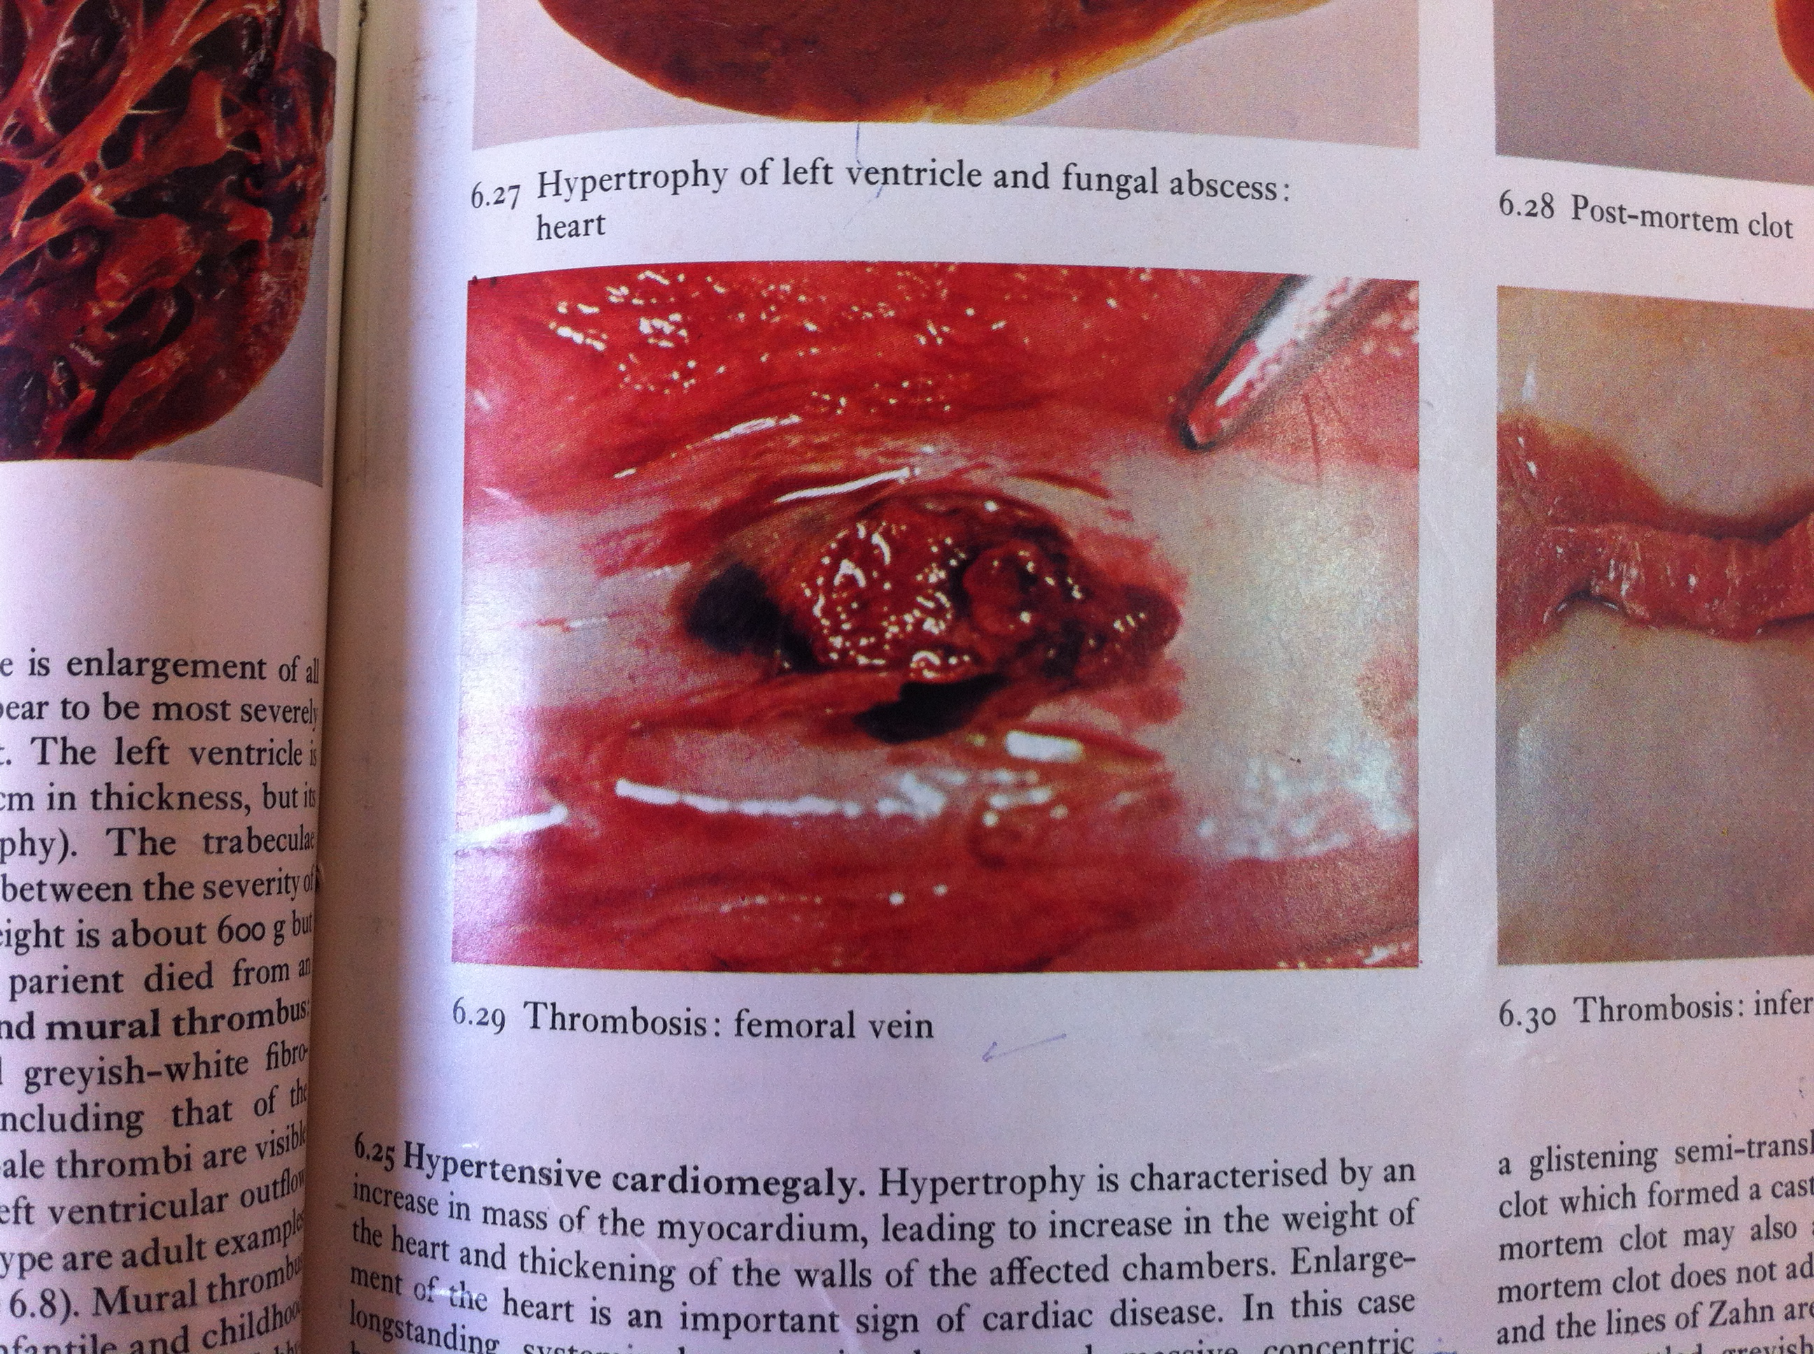
Thrombosis : femoral vein

Slide 7
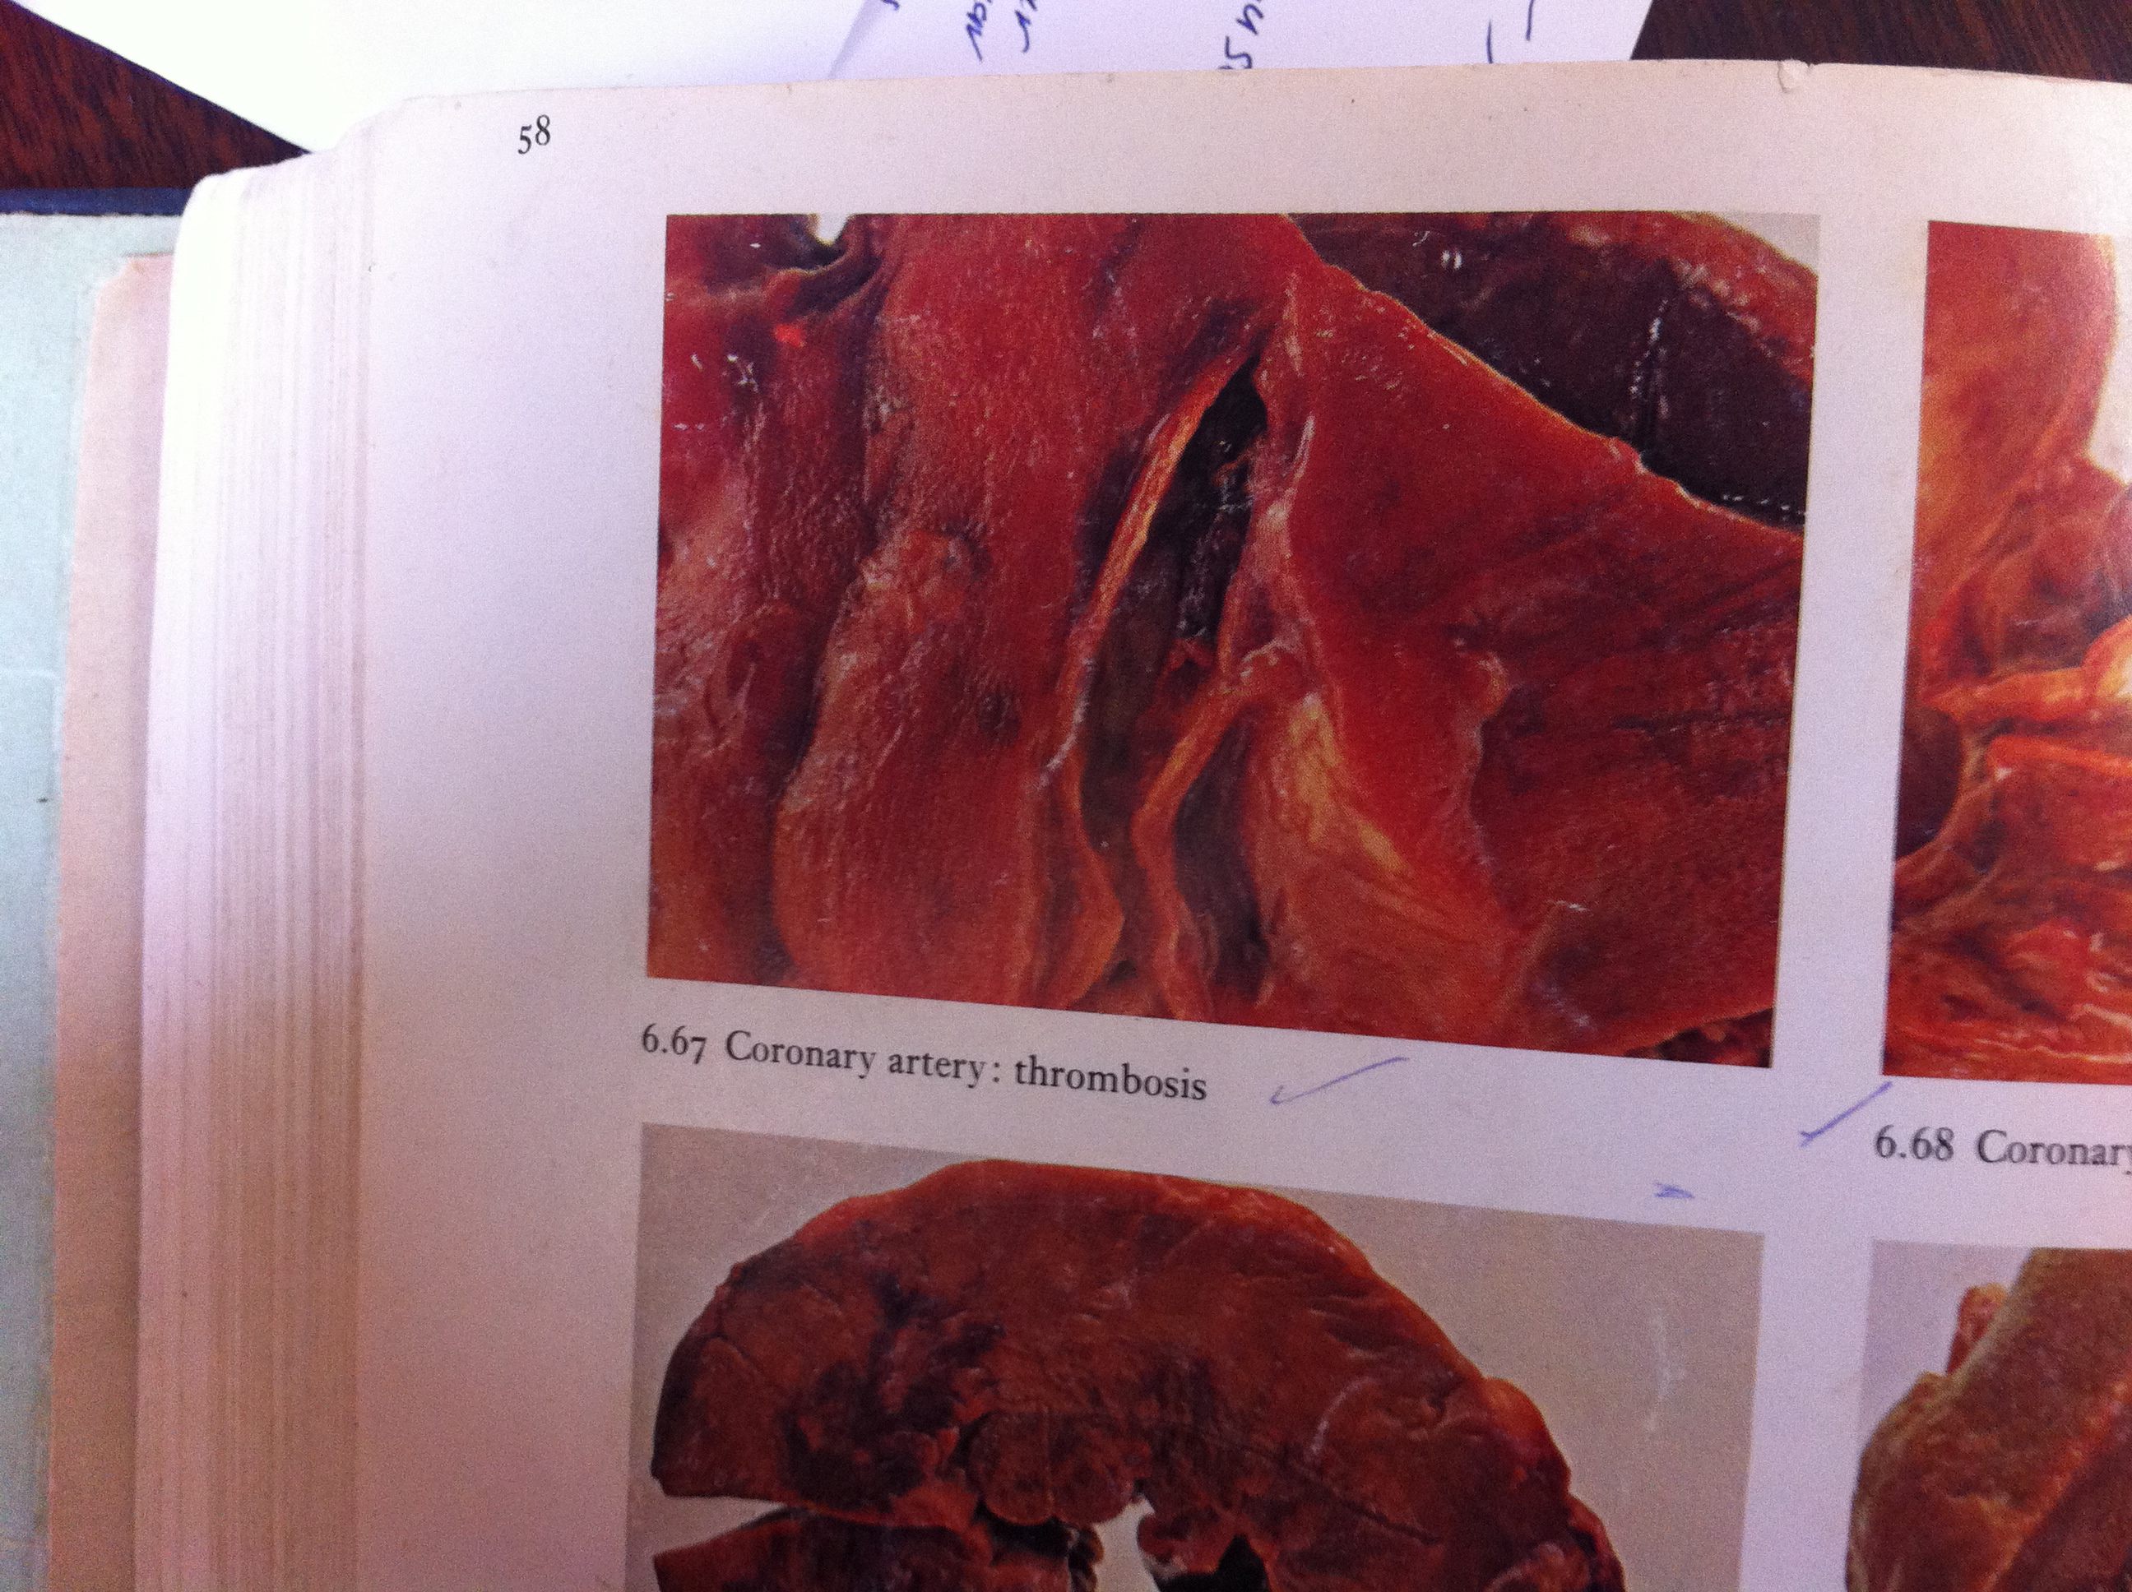
Coronary artery: thrombosis

Slide 8
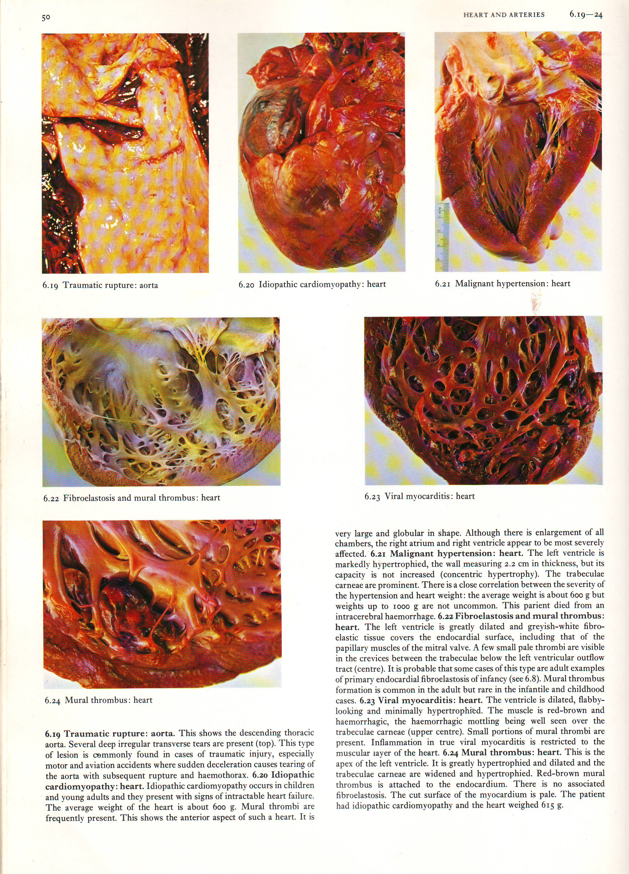
Mural thrombus : heart

Slide 9
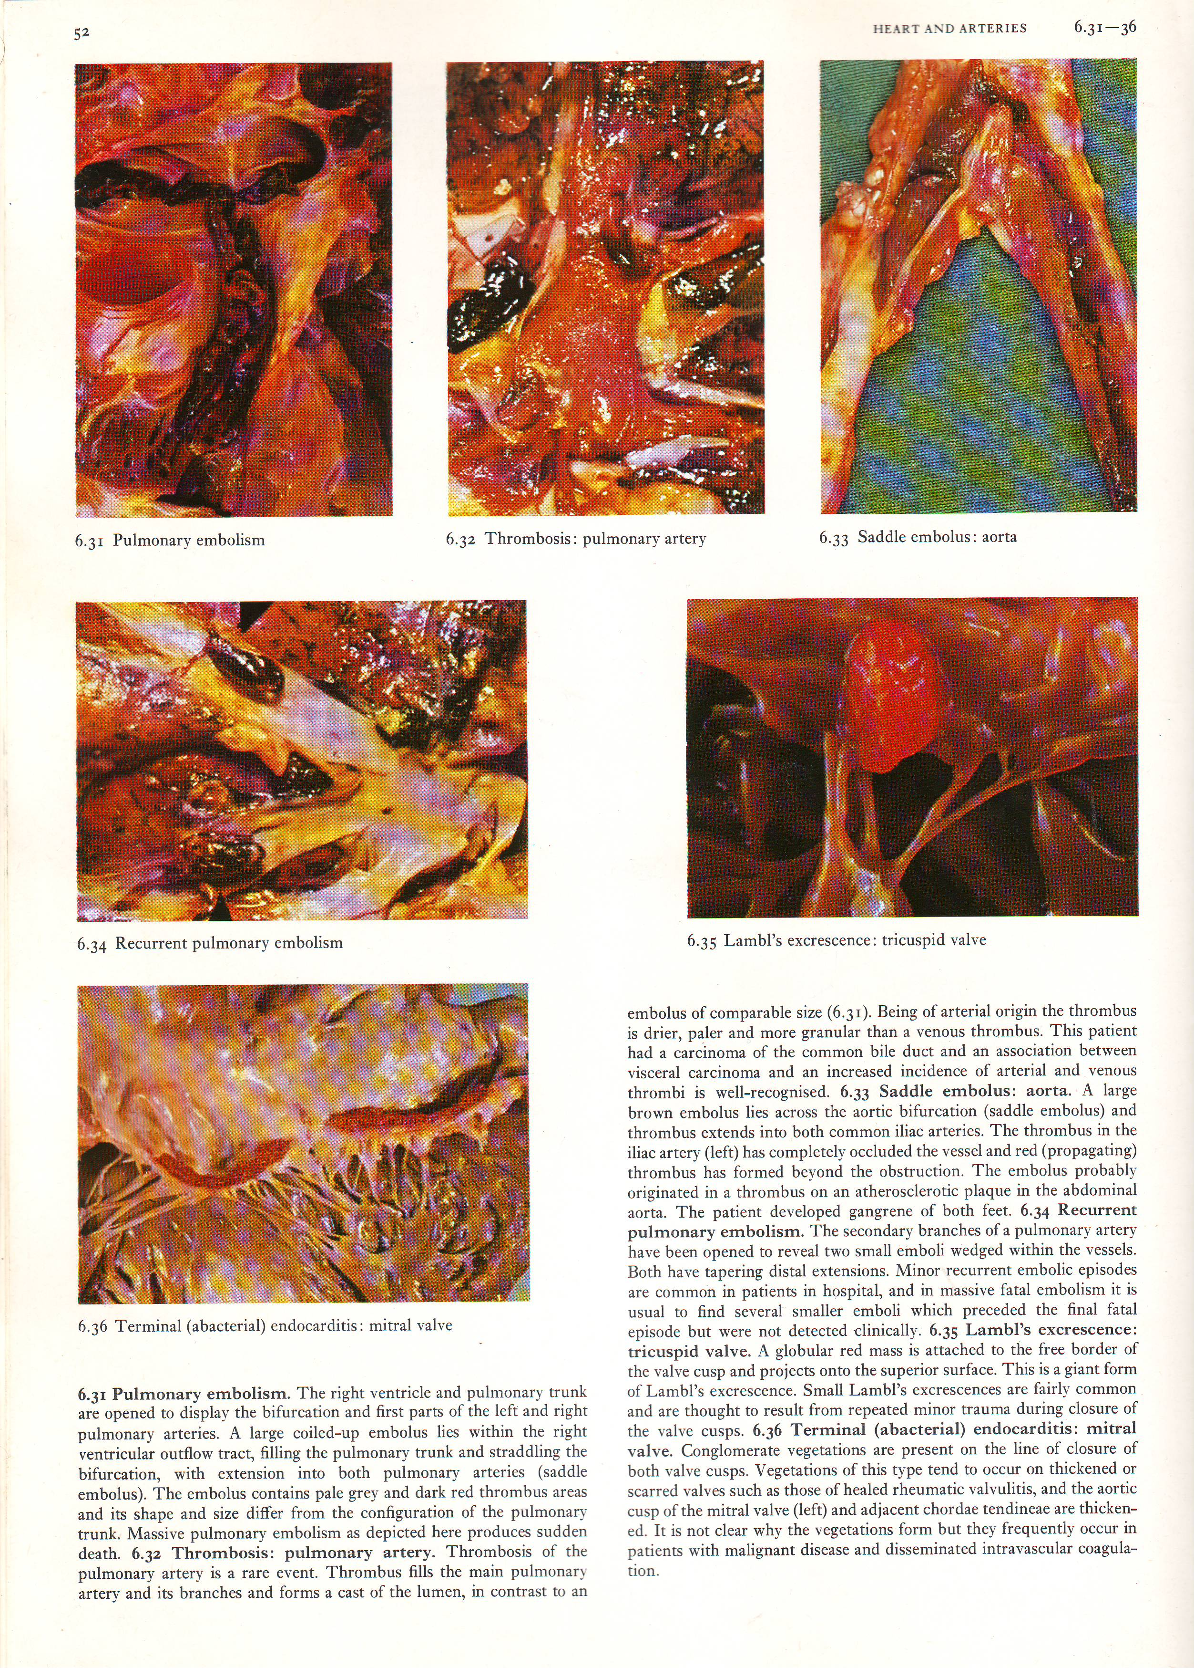
Saddle embolus : aorta

Slide 10
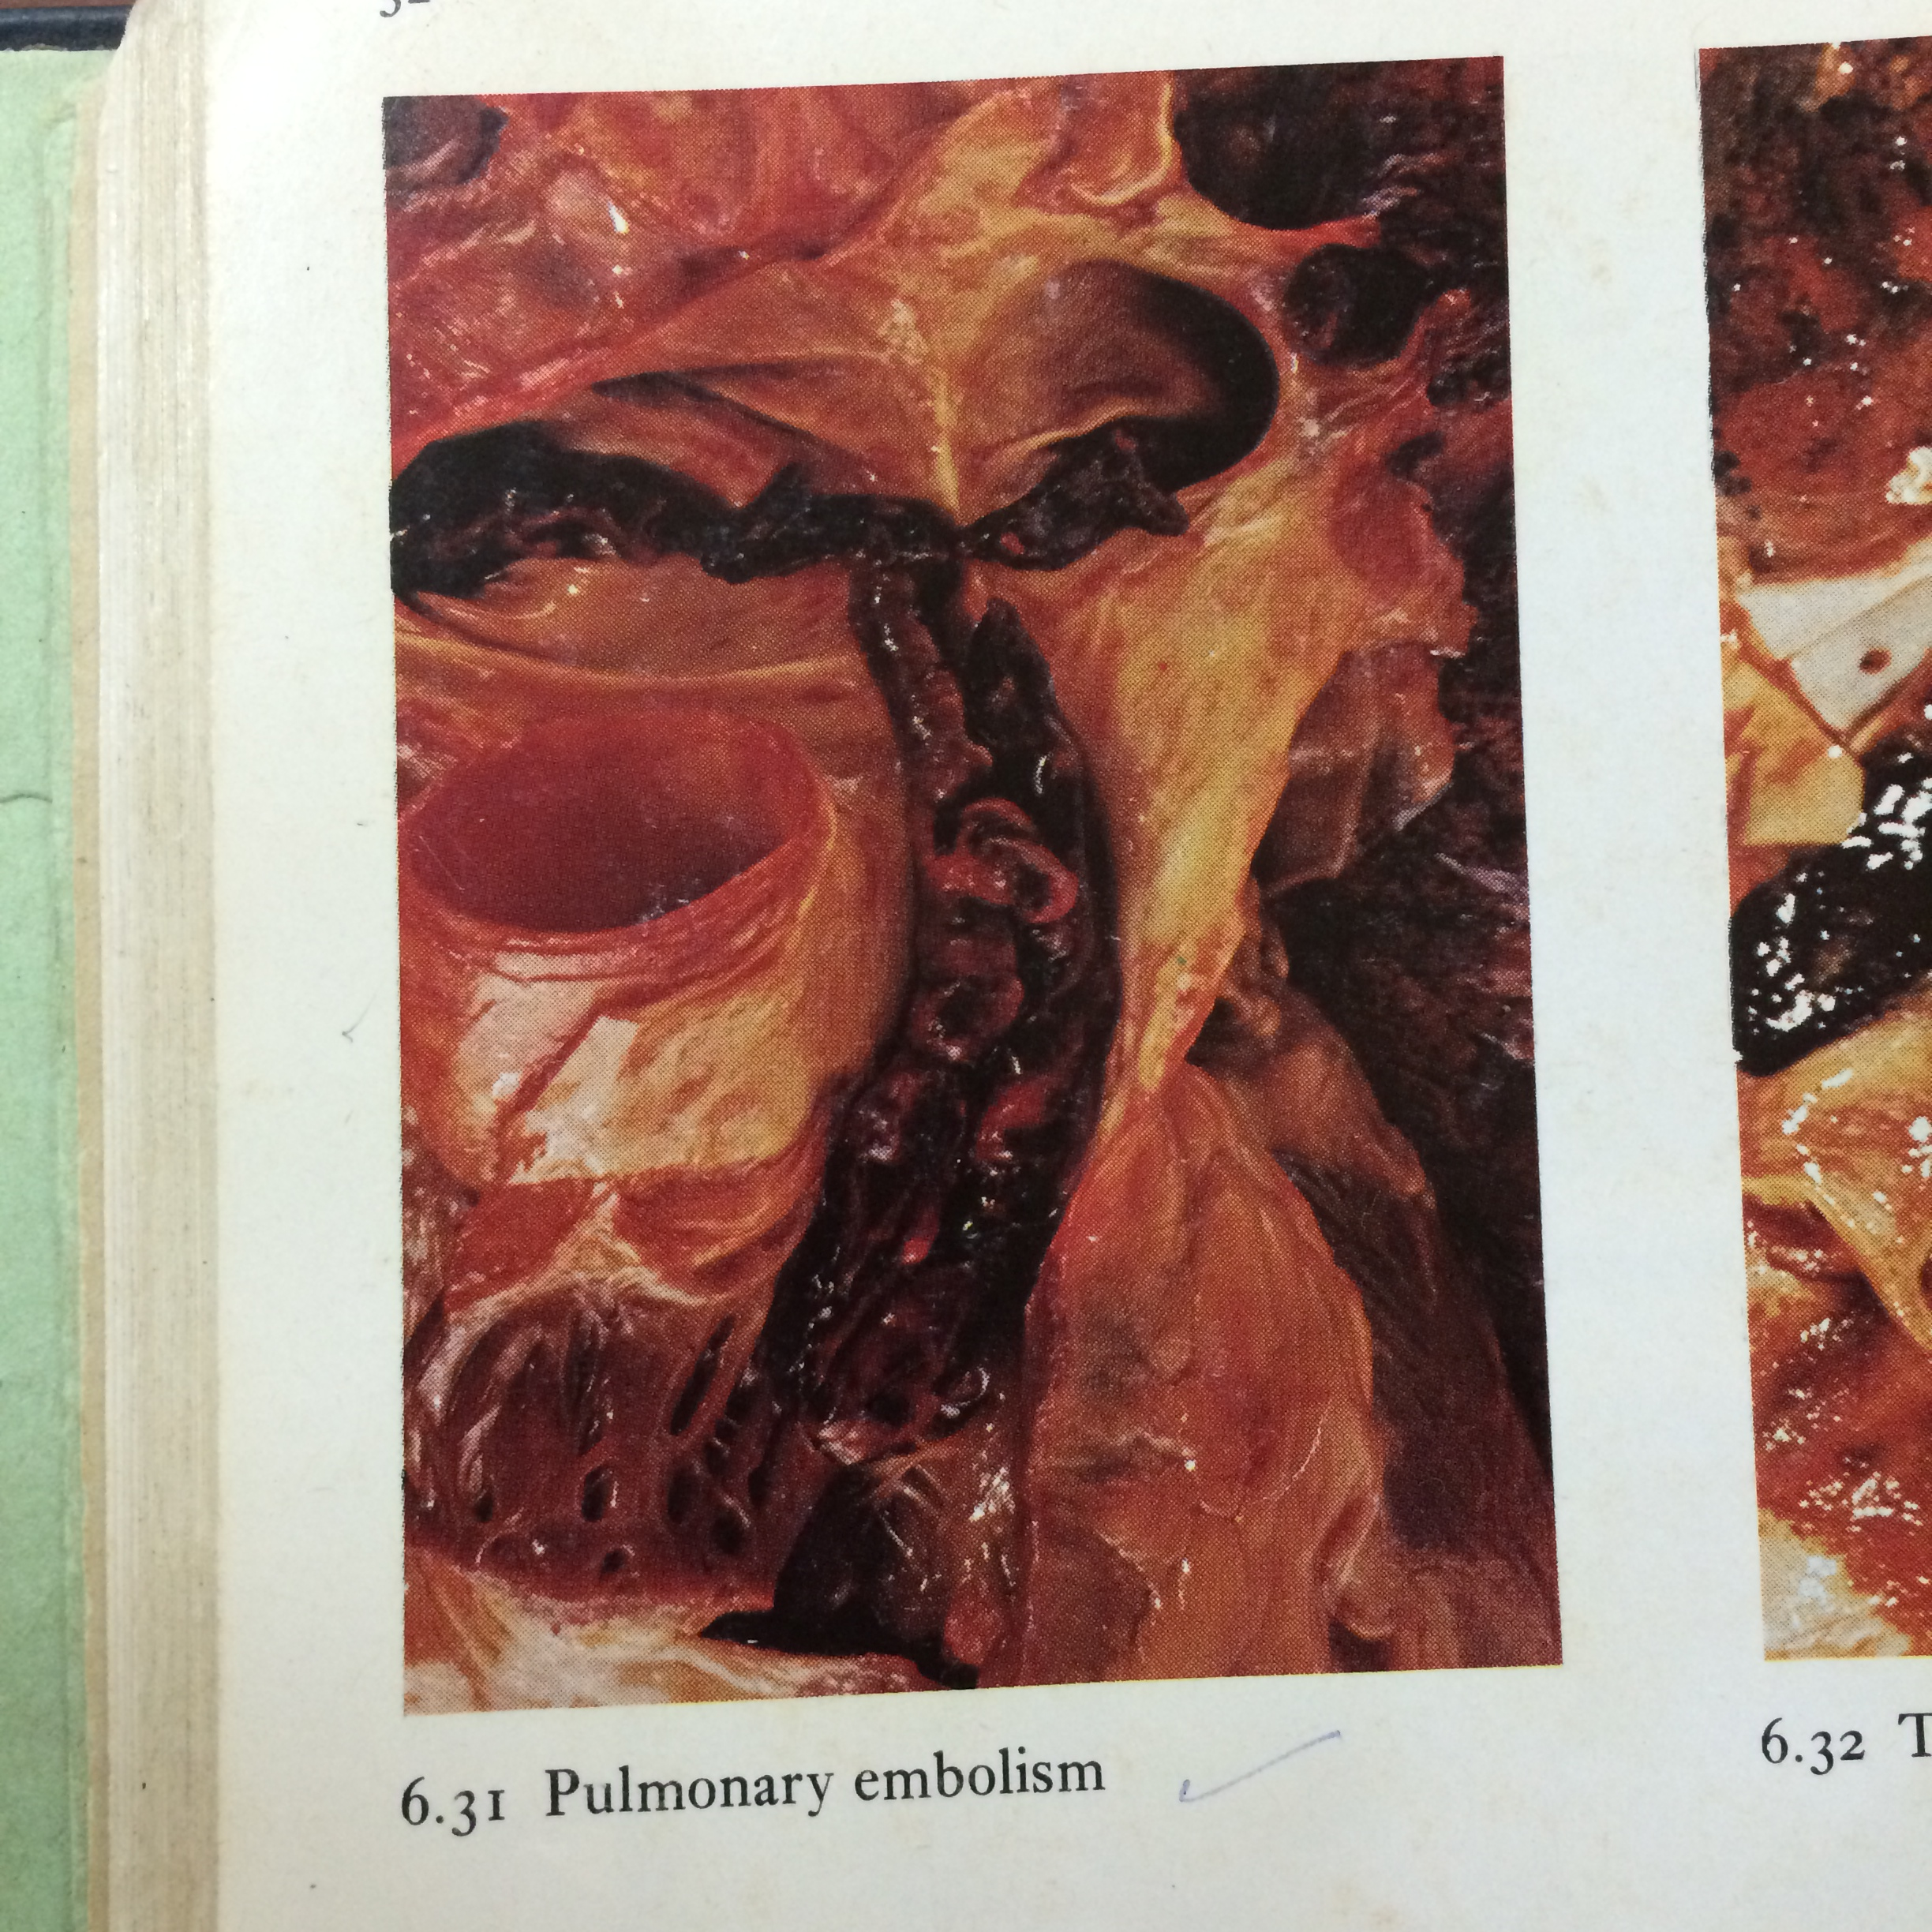
Pulmonary embolism

Slide 11
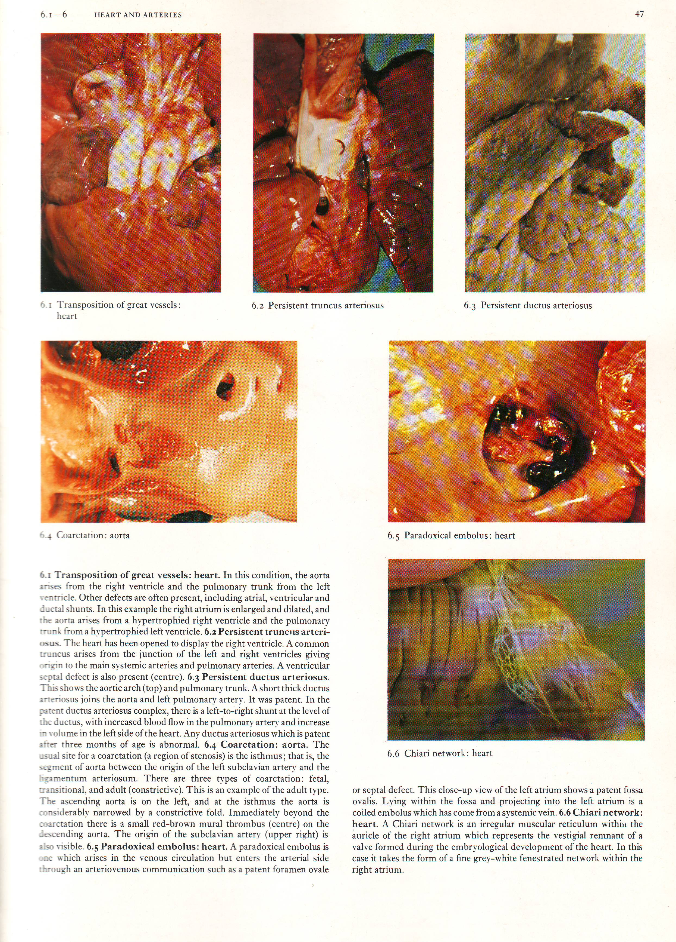
Paradoxical embolus : heart

Slide 12
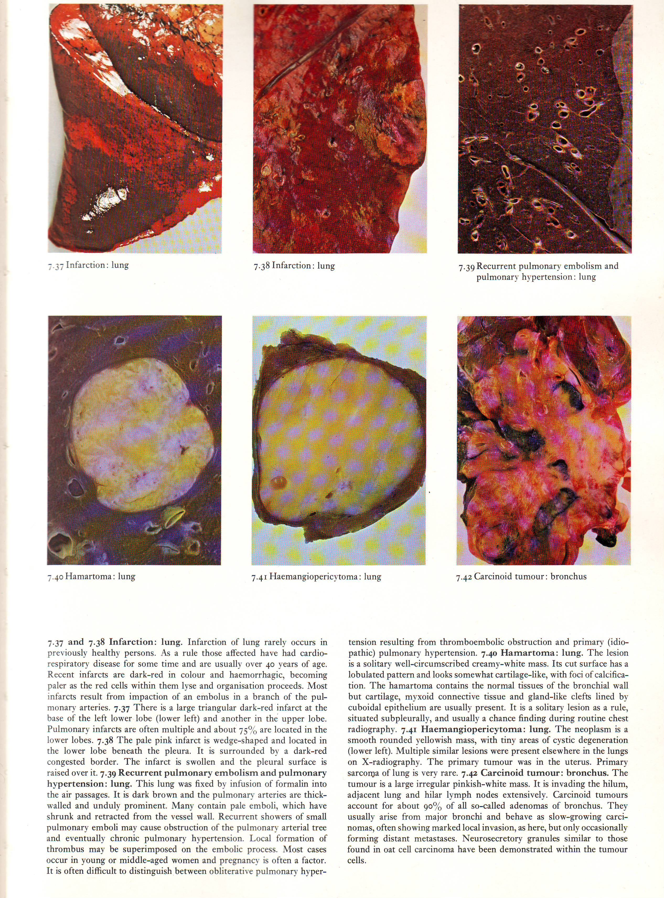
Infarction : lung

Slide 13
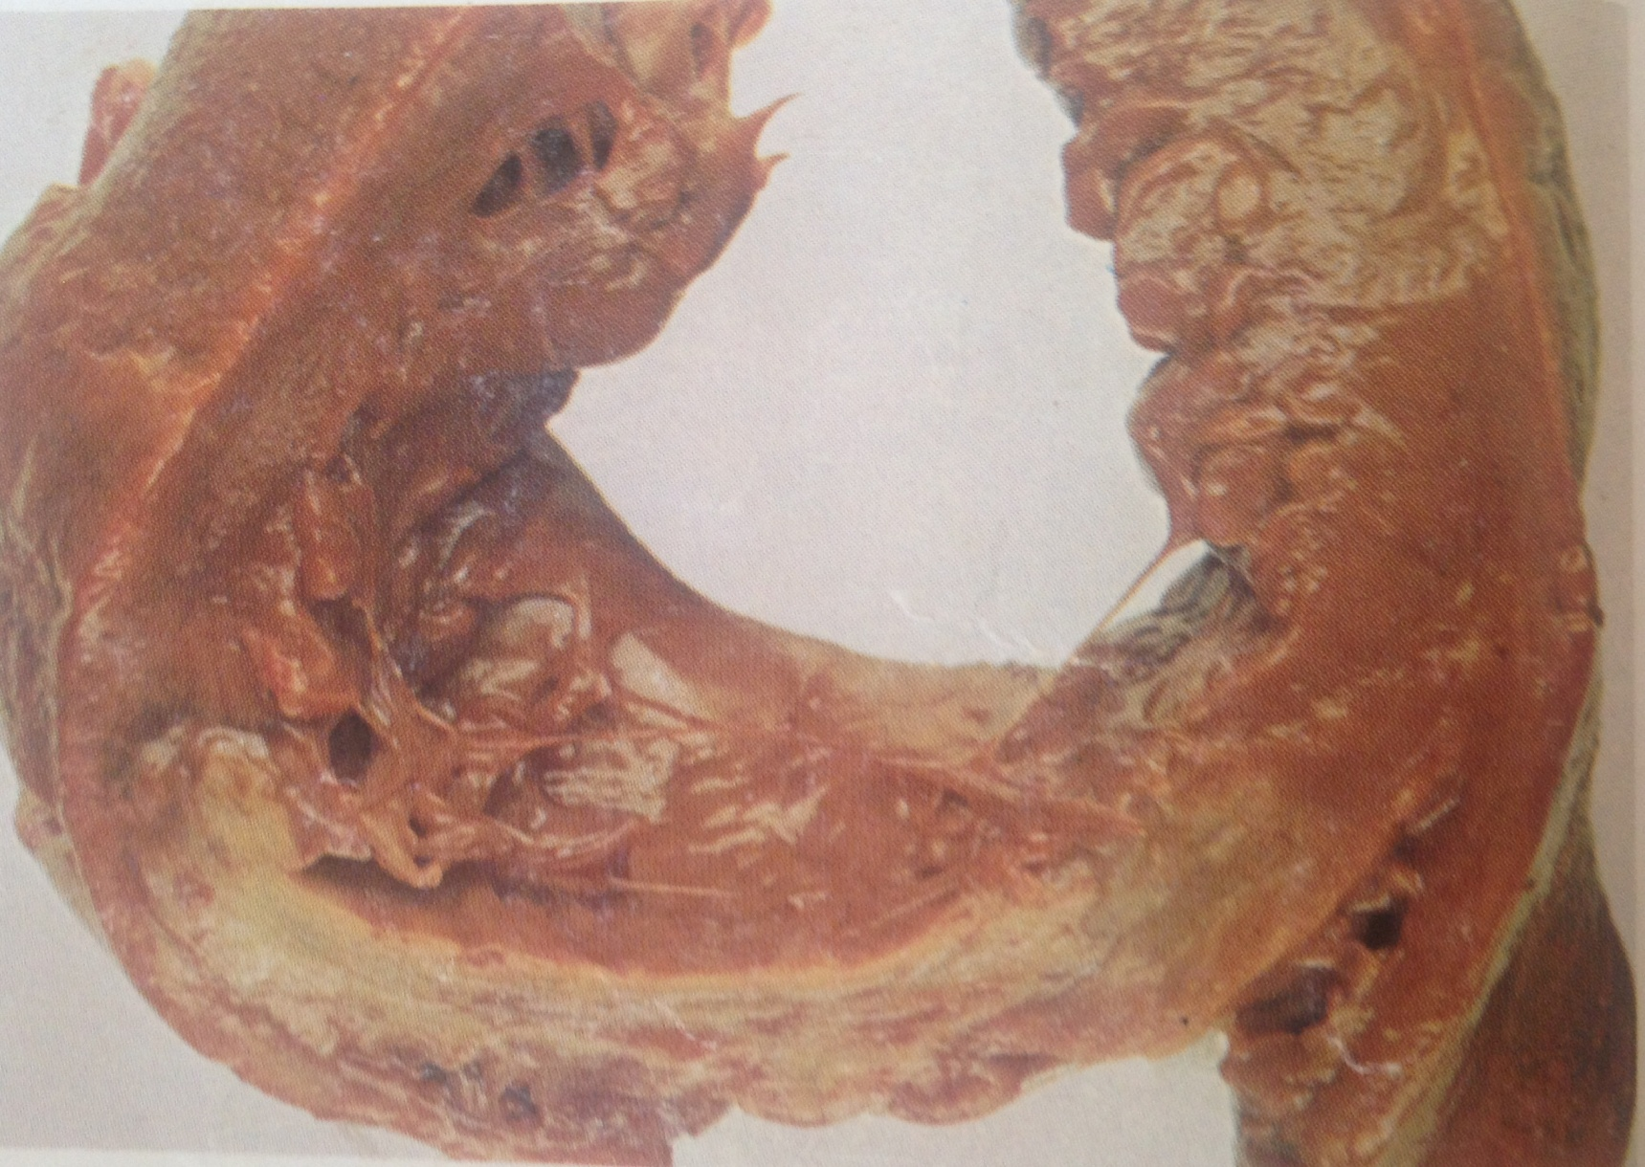
Infarction of myocardium

